Slide 1
Measuring search times in various data structures
István Finta

Slide 2
The Data Structures
The standard library:
My own:

Slide 3
The Data Structures
The standard library:
std::map
Red&black tree
My own:

Slide 4
The Data Structures
The standard library:
std::map
Red&black tree
std::unordered_map
Hashmap with buckets
Each bucket is a linked list
Tested both with its dynamically calculated bucket count and various manually set values
My own:

Slide 5
The Data Structures
The standard library:
std::map
Red&black tree
std::unordered_map
Hashmap with buckets
Each bucket is a linked list
Tested both with its dynamically calculated bucket count and various manually set values
My own:
BinTree
Simple binary tree
Stores data on the heap

Slide 6
The Data Structures
The standard library:
std::map
Red&black tree
std::unordered_map
Hashmap with buckets
Each bucket is a linked list
Tested both with its dynamically calculated bucket count and various manually set values
My own:
BinTree
Simple binary tree
Stores data on the heap
BinTreeCont
Very similar to BinTree
The only difference is that it stores its Nodes in an std::vector

Slide 7
Node
Extremely simple:
One key (uint64_t)
Two pointers
This was used in all data structures, even ones that didn’t need it (which was most of them)

Slide 8
The Benchmark
Creating the benchmark:
One C++ file (+1 header)
nanobench
One bash script

Slide 9
The Benchmark
Creating the benchmark:
One C++ file (+1 header)
nanobench
One bash script
Parameters:
Node count
Test iterations
Custom bucket count
Generator and tester seeds

Slide 10
The Benchmark
Creating the benchmark:
One C++ file (+1 header)
nanobench
One bash script
Parameters:
Node count
Test iterations
Custom bucket count
Generator and tester seeds
Running the benchmark:
If it takes too long, the system terminates it

Slide 11
The Benchmark
Creating the benchmark:
One C++ file (+1 header)
nanobench
One bash script
Parameters:
Node count
Test iterations
Custom bucket count
Generator and tester seeds
Running the benchmark:
If it takes too long, the system terminates it
Three steps:
Hardcode parameters into bash script

Slide 12
The Benchmark
Creating the benchmark:
One C++ file (+1 header)
nanobench
One bash script
Parameters:
Node count
Test iterations
Custom bucket count
Generator and tester seeds
Running the benchmark:
If it takes too long, the system terminates it
Three steps:
Hardcode parameters into bash script
Run small batch

Slide 13
The Benchmark
Creating the benchmark:
One C++ file (+1 header)
nanobench
One bash script
Parameters:
Node count
Test iterations
Custom bucket count
Generator and tester seeds
Running the benchmark:
If it takes too long, the system terminates it
Three steps:
Hardcode parameters into bash script
Run small batch
Repeat

Slide 14
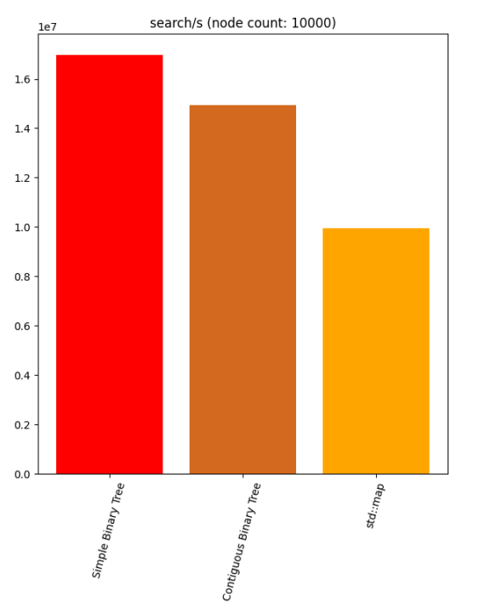
Interesting Results
My binary tree is about twice as fast as std::map

Slide 15
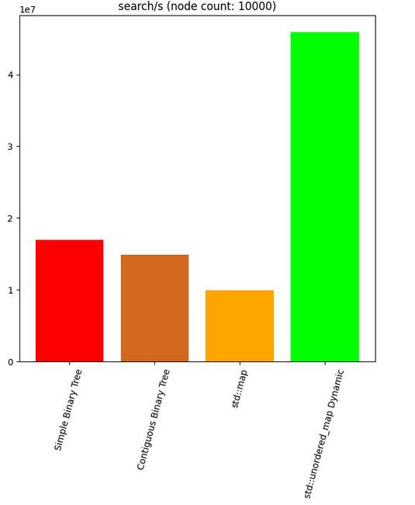
Interesting Results
My binary tree is about twice as fast as std::map
Though std::unordered_map is significantly faster

Slide 16
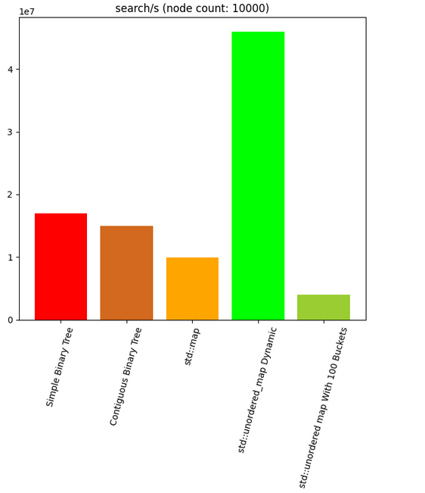
Interesting Results
My binary tree is about twice as fast as std::map
Though std::unordered_map is significantly faster
(if it has enough buckets)

Slide 17
Conclusion
std::unordered_map is really good at dynamically choosing the right bucket count

Slide 18
Conclusion
std::unordered_map is really good at dynamically choosing the right bucket count
std::map has something weird going on

Slide 19
Conclusion
std::unordered_map is really good at dynamically choosing the right bucket count
std::map has something weird going on
Better code architecture will make your life much easier

Slide 20
Thank You

